Slide 1
EAUX TROUBLES
(TURBID WATER) Publishing
Eaux Troubles is a young publishing house based in Lausanne, Switzerland, that specialises in publishing suspense novels in a range of genres, from whodunits, crime novel to spy stories and thrillers.
We only publish francophone writers from around the world, whether they are young rising stars or established authors.
Eaux Troubles’s key aim is to help our authors find and reach as wide a readership as possible and achieve sales success. Our editorial approach is to publish books that have literary merit but are also accessible to all readers.
Eaux Troubles published 16 novels in 2020, with a further 22 scheduled for publication in 2021. We are keen to remain modest in size in order to retain our human touch, be in a position to support our authors as best possible and in doing so offer readers entertaining works of outstanding quality.
MARK ZELLWEGER
Co-founder EAUX TROUBLES (Turbid Water) Publishing
EAUX TROUBLES publishing - Chemin des Écureuils 7 CH-1009 PULLY - Tel : +41 79 365 90 79Email : info@editionseauxtroubles.com - www.editionseauxtroubles.com

Slide 2
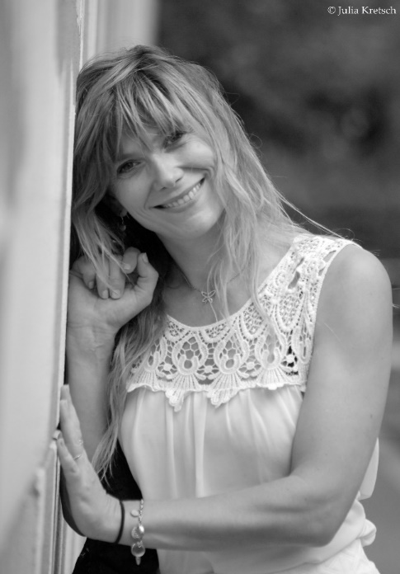
Foreign Rights
23 février 2021
CENDRINE BERTANI
Cendrine Bertani has been a teacher of Classics at the Lyon Academy for twenty years. Her saga of the Legions of Hades, which mixes a thriller tone with a historical narrative, takes on heroic-fantasy accents by staging ancient vampires, in the service of Hades, capable of embodying themselves in our present. The first volume of the series, acclaimed by the school public,. It was selected for the Prix Littérature Jeunesse de l'Antiquité in the "lycée" category
Les Légion d’Hadès, Le réveil (The Legion of Hades, the awakening ) 2019
An absolutely addictive new saga, strange and odious crimes are perpetrated in our time in the dark streets of Athens. Who are they? Why? At the same time the reader will travel back in time with the characters, to Ancient Greece, the time of the pantheon of the Gods. An immersion in an unknown world, meeting sects, demons, chimeras and legionnaires of evil. A first volume that will enslave and bewitch the reader and will make him eager to know the rest of the destiny of each of the characters. Welcome to the world of Hades, god of darkness.
Athens. A famous archaeologist is murdered. The sect of Hades worshippers awaits the return of the Legionary. Is it a man, a beast, a demon? Students of the Erasmus device, keen on ancient history, are ready to go back in time to prevent the world from falling into chaos. Between past and present, choices will have to be made. The Tmima team, guided by Manolis Niagas, will learn this. Just like Milos, the victim's son, or Alexos, the young protégé of Pericles.
works to be published by EAUX TROUBLES:
The Legions of Hades, Aurelia. February 2021
EAUX TROUBLES publishing - Chemin des Écureuils 7 CH-1009 PULLY - Tel : +41 79 365 90 79Email : info@editionseauxtroubles.com - www.editionseauxtroubles.com

Slide 3
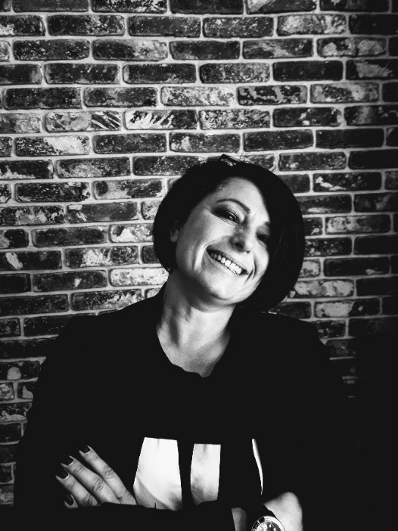
Foreign Rights
23 février 2021
SACHA ERBEL
Sacha Erbel has been a police officer for 25 years. She has been working for 16 years at the SDLP (Protection Service) where she ensures the close protection of political and civil personalities. Passionate about the study of the behavior of serial criminals for many years, she resumed her studies in parallel with her work and obtained a degree in Applied Criminology at the Mental Expertise of the René Descartes Faculty of Medicine in Paris, in January 2016.
L’emprise des sens (The power of the senses) 2020
L'emprise des sens is the first volume where we discover Talia's adventures. A thriller rooted in the voodoo cult of New Orleans. Serial crimes, domestic violence, the important thing is to go back to the origin of the evil that befell Talia. Between psychology, criminology and the supernatural, a trip to New Orleans is absolutely exotic.
When Talia, in the midst of sentimental disillusionment, takes off for a dream vacation in New Orleans, she is far from imagining that her destiny awaits her there.The very next day, she finds herself mixed up in a crime, executed according to a macabre and violent ritual.Voodoo rituals or serial crimes, the line between the two seems blurred for Louis Lafontaine, the police officer in charge of the investigation, who is himself confronted with obsessive troubles. With his teammate, he is ready to do anything to go back to the source of the horror.Faced with the grip of evil, will Talia be able to confront her demons and the terrifying gift revealed to her? Will the support of Azaïa, an eccentric priestess, and the love of Basil be enough to help her?In the biting heat of this trip to Cajun country, tormented spirits reveal themselves, traumas resurface and unavowable fears collide until the final revelation.
works published by EAUX TROUBLES:
The Shadow of Nola
Eugene Terredefeu
EAUX TROUBLES publishing - Chemin des Écureuils 7 CH-1009 PULLY - Tel : +41 79 365 90 79Email : info@editionseauxtroubles.com - www.editionseauxtroubles.com

Slide 4
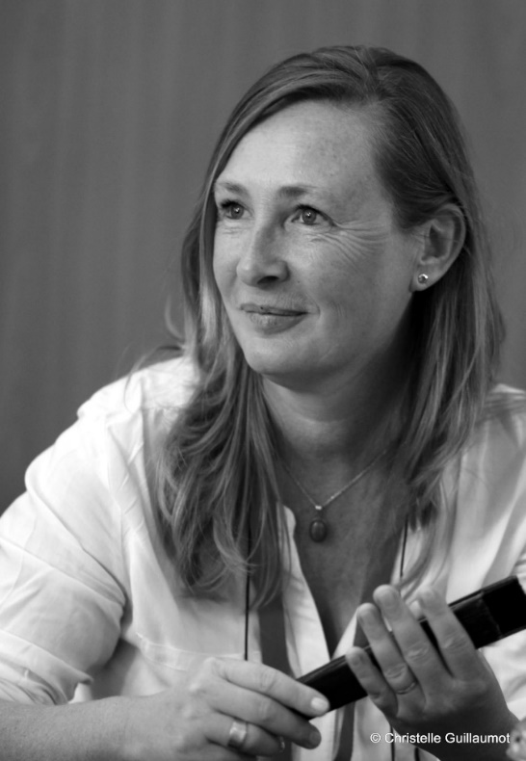
Foreign Rights
23 février 2021
Sandrine Roy
Born in Bègles (Bordeaux), Sandrine Roy studied Modern Letters which affirmed her already pronounced taste for reading and writing which she has practiced since her earliest childhood. For the past 14 years, she has been living near Montauban where she works in a school environment.
Dilemme (Dilemma) 2020
A thriller on the theme of serial murders. The trigger is the resurgence of a distant past that sets the tone for violent revenge. The investigation will be carried out by a very atypical police team. A dark story ingrained in the facts of our society, but not unraveled in a good mood despite the darkness.
In the 2000s, a killer is about to crack down on a family in a Parisian suburb, observing his prey as closely as possible before taking action.Many years later, he reoffends, operates at night and decimates entire families.What is the motivation of this killer of a new kind that knows no mercy?Of all these massacres, only one survivor remains, little Nathan, who will be entrusted to the care of Agathe Delcourt, in a specialized institute in Normandy.Lieutenant Louis Salvant-Perret, nicknamed the Prince of the Central, not without reason, will try to find out who this lawless assassin is. Far from the anti-hero of contemporary detective stories, the investigator deploys his quiet strength to track down the murderer. He will be helped in this terrible investigation by his group of personalities as surprising as they are effective.When the dark family ties come to the surface, one must expect a well-crafted investigation, surrounded by complex relationships, between shivers and emotions!
EAUX TROUBLES publishing - Chemin des Écureuils 7 CH-1009 PULLY - Tel : +41 79 365 90 79Email : info@editionseauxtroubles.com - www.editionseauxtroubles.com

Slide 5
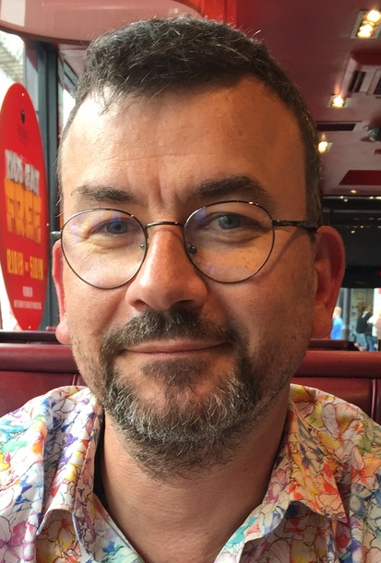
Foreign Rights
23 février 2021
MICHAEL FENRIS
Michael Fenris was born in 1968, a general practitioner from Nancy. He has lived in the Paris region since 2002 with his wife and three children. Writing since the age of eleven, mostly in the evenings and at night, he explores various worlds ranging from short stories, to gothic horror, science fiction and fantasy. His sources of inspiration are multiple, from Hodgson to King, from Lovecraft to Connelly, without forgetting the one who really made him want to write, Henri Vernes father of Bob Morane, and who gave him his approval to take over some of his characters.
Michael Fenris writes 100% vintage thrillers in the vein of Dashiell Hammett or Raymond Chandler. Beautifully done!
Vengeance sur pellicule (Revenge on film ) 2020
A new investigation by private detective Jefferson Fergusson, in a detective novel always with an attractive vintage style. An atypical private detective who will have to face his past and find himself in situations he would have preferred to avoid. Thanks to the writing style, the visual sensations, fears and anxieties are very present in this story. We find ourselves immersed in the darkness and corruption of The City: Resilience.
Simon Crane, Jeff Fergusson's best friend and colleague, is found dead, shot in a squalid alleyway. While suspicions turn to the detective, Simon's wife Susan, with whom he is in an adulterous relationship, confesses to him that she is guilty of the murder. Unable to denounce her, Jeff lets her run away to Hollywood, where she dreams of becoming a great actress under the thumb of a mob boss.
Fifteen years later, Fergusson is called by the new police chief to identify a body. It is Susan, murdered in a shabby hotel room with her business card in her coat as a clue.
What could have motivated her return to Resilience, and why after so many years of silence? All the elements seem to be coming together against Fergusson. Only one thing is certain, she was trying to contact him.
The detective has little choice: he will have to go back to his past to find the culprit in the present...
A second investigation by our atypical private detective Jeff Fergusson that will again delight fans of black thrillers, always with a powdery scent!
works published by EAUX TROUBLES: Diamonds on Maccabees
EAUX TROUBLES publishing - Chemin des Écureuils 7 CH-1009 PULLY - Tel : +41 79 365 90 79Email : info@editionseauxtroubles.com - www.editionseauxtroubles.com

Slide 6
Foreign Rights
23 février 2021
PHIL SMANS
Phil Smans is a polytechnic engineer and holds an MBA (Master of Business Administration).
After 20 years of managerial positions in several multinational companies, in Belgium and abroad, he has been able to measure the impact of high technology on our lives, as well as the degree of excitement of technical innovation.
He has also noticed the striking power of storytelling, a narrative structure close to tales. Taking the opposite approach to traditional managerial literature, he then published a book on a technical and difficult organizational subject, but containing several fictionalized case studies.
The result was spectacular: published in three languages, the book was a bestseller in its field.
From corporate storytelling to a true suspense novel, there was only one step left to take?"
La Liste Alpha (The Alpha List) 2020
he "Big Brother" of the 21st century is on the march, a thriller of anticipation that is chilling. An appallingly powerful computer program capable of selecting a certain type of population anywhere on the planet. A new kind of eugenics is likely to spread, a race against time to stop the machinations.
Detroit, one evening in February 2016. The lover of a poor peasant's son in an isolated region in northwestern Mexico. A young Rwandan woman survivor of the Tutsi genocide. A young logger in a logging camp deep in the Indonesian forest. At first glance, nothing seems to connect the destinies of these three people... And yet, there is one thing in common: a software program, over-powerful, tested by a multinational company. But things aren't going quite as planned... which leads the boss of the IT company to impose a freeze on experimentation on his project manager. Nevertheless, a radical environmentalist group manages to steal the software, and starts using it to achieve its ends: a demonic plan is now put in place. The young project leader, Patrick Doyle, is now engaged in a desperate chase to avoid a planetary cataclysm. Faced with the magnitude of the threat, the secret services around the world are mobilized, but a leader of the terrorist group manages to blend in with nature and relaunch her fanatical fight. The face-to-face with Patrick Doyle will prove to be ruthless...
works to be published by EAUX TROUBLES:
Conjuration Delta. March 2021
EAUX TROUBLES publishing - Chemin des Écureuils 7 CH-1009 PULLY - Tel : +41 79 365 90 79Email : info@editionseauxtroubles.com - www.editionseauxtroubles.com

Slide 7
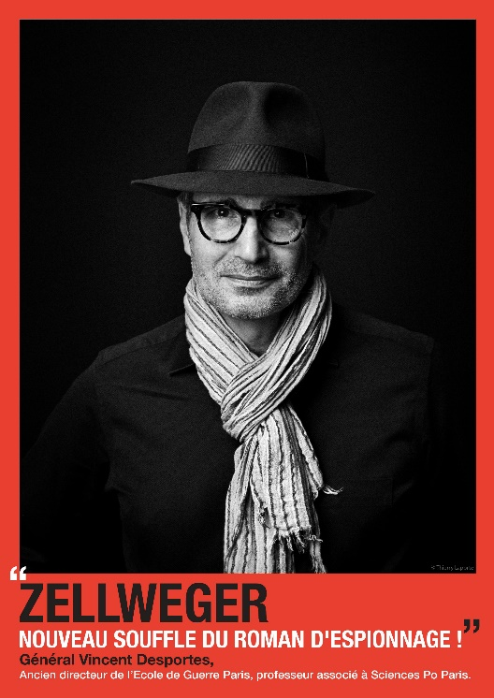
Foreign Rights
23 février 2021
MARK ZELLWEGER
MARK ZELLWEGER is a Swiss author from the canton of Fribourg. He was born on 3 January 1959 and is married with two children. He has a degree in Roman History from the Sorbonne and in Strategic Marketing from two business schools.
He was a director of sales and marketing in the pharmaceutical industry in Switzerland as well as abroad for thirty-odd years.
He was also a special advisor to the directors of leading international intelligence agencies.
He now devotes himself entirely to writing and is considered to be “the new master spy novelist” by numerous critics in the field. Some go as far as to include him in the exclusive club of great authors of the genre, such as Follett, Ludlum, Clancy and Higgins.
Mark Zellweger’s career as a writer began with the publication in September 2014 of L’Envol des Faucons (Flight of the Falcons), the first book in the Réseau Ambassador (Ambassador Network) series. Frères ennemis (Brothers and enemies) is his tenth novel.
Xtrême préjudice (Xtreme Prejudice) was nominated for the 2017 French-speaking Swiss Detective Novel Prize Lausan’noir Festival 27-29 October 2017.
Frères ennemis ( Brothers and enemies) March 2021
Before his death on 15 November 1971, Colonel William Fischer of the KGB left his memories to his neighbour. Her granddaughter, a young thirty years old Russian, falls on it fifty years later. She turns it into a novel! Here it is!
Alexei and John are veterans in the Soviet and American spy services as they meet for the first time in the nest of spies that Berlin became in the middle of the blockade in June 1948.
These two extraordinary young men make us experience the merciless struggle between the West and the Soviet Union through the intermediary of their agents. The master spies lurk in the shadows. Are the most implacable spies the ones we think they are? Who are the moles on each side?
Mark ZELLWEGER's exciting new series: Cold War.
BY THE "MASTER OF THE SPY NOVEL. "La Dépêche du Midi”
EAUX TROUBLES publishing - Chemin des Écureuils 7 CH-1009 PULLY - Tel : +41 79 365 90 79Email : info@editionseauxtroubles.com - www.editionseauxtroubles.com

